Slide 1
Logical Modelling Of Biological Regulatory Networks With GINsim
Presented by: Abdullah

Slide 2
Outlines
Model
Availability
Biological Regulatory Networks
About GINsim
Drawing the regulatory graph
Interaction And Their Activity Ranges
Running A Simulation

Slide 3
Availability
GINsim 2.3 is freely available for academic users. The GINsim website provides the latest official version of the software, documentation, as well as a model library.
(http://ginsim.igc.gulbenkian.pt).
Download the java JDK file 16.0.2

Slide 4
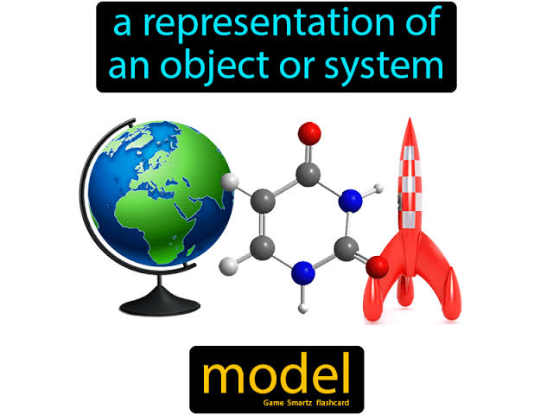
What is Model
A model of an object is a physical representation that shows what it looks like or how it works. The model is often smaller than the object it represent.

Slide 5
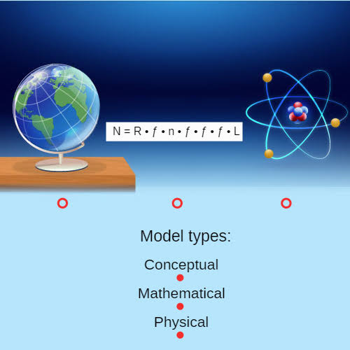

Slide 6
What is Modelling ?
Modelling (Develop Built a Conceptual Model)
Conceptual model is defined and built up with respect to specified research purpose using data and information collected, in order to represent relationships that are relevant to the research problem as known as conceptual model.

Slide 7
Modelling & Simulation
Modeling and simulation is defined by Bratley as a process of driving a model of a system with suitable inputs and observing the correspondingly outputs.

Slide 8
Biological Regulatory Networks (BRN)
Biological regulatory networks (BRN) are usually represented by a directed graph }=(V , E). Where nodes represent the set of all components V, and the set of signed edge E < {(u, v, t): u, v belong to V; t belong to (+ , -) represent regulatory interaction. Sign t edge represent a Positive interaction (Activation), or Negative Interaction (Inhibition).

Slide 9
About GINsim
GINsim is a tool using for simulation and the analysis and regulatory graphs, based on multilevel logical formalism.
Two Type Of Formalism Graphs :
Regulatory Graph (Which model regulatory networks).

Slide 10
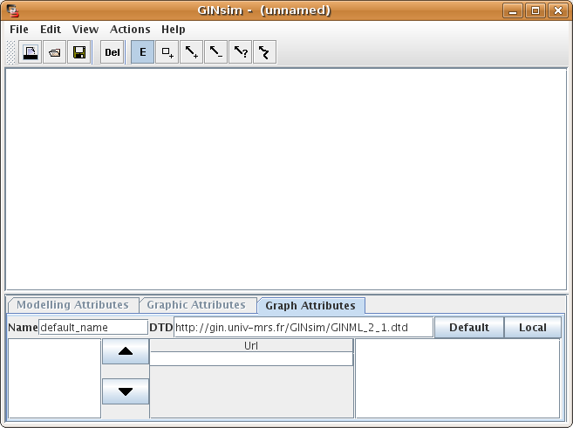
2. State Transition Graph (Which represent the dynamically behaviors for a given initial states and under some updatino).
Main Window Of GINsim

Slide 11



Drawing The Regulatory Graph
Default Editing Mode
Allow to select and move object.
State Insertion Mode
When selected , clicking on the graph panel adds a new state
Delete Insertion Mode
When Selected Items to discard the object.

Slide 12




Activation Insertion Mode (Interaction)
Activation
Inhibition Insertion Mode (Interaction)
Inhibition

Slide 13
Activation
Entity / State e1 activation of another Entity / State e2 then e1 is the positive regulator for e2. In this case, every time the concentration of e1 enhances or reduces, it will affect the concentration of e2 in similar manner. e1 slightly changes the rate of activation of e2.

Slide 14
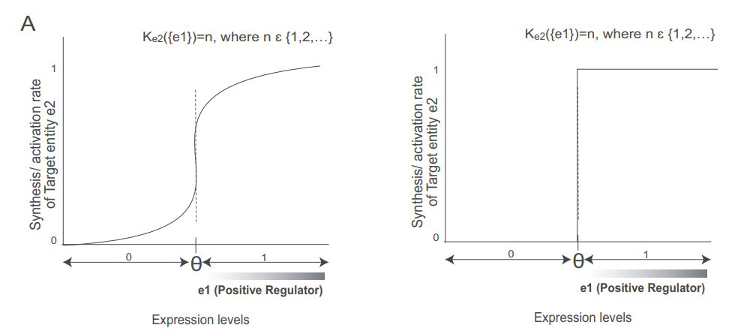
Activation Graph

Slide 15
Inhibition
Entity e3 decreases the rate of activation of another entity e4, then e3 can be called as negative regulator or inhibitor of e4 and the process is called as negative regulation or inhibition. The process of inhibition also depends on the threshold levels of e3 showing that whenever the concentration level of e3 reaches its threshold level then e3 will be efficient in decreasing the activation levels of e4, up to a level where e4 can be completely inactivated or its affect in the system is abolished.

Slide 16
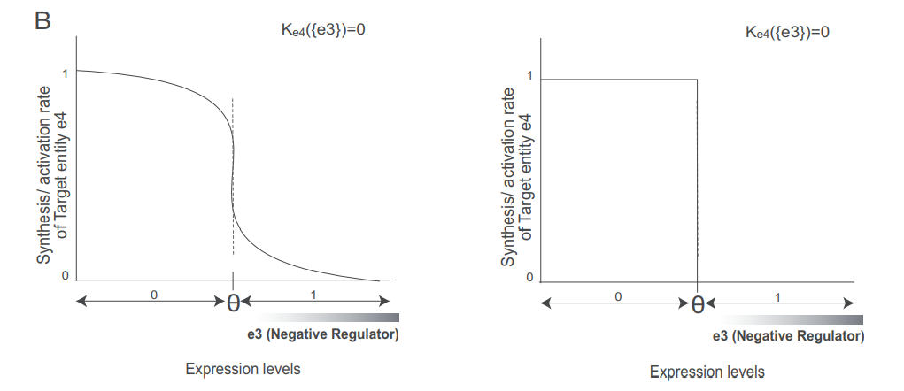
Inhibition Graph

Slide 17
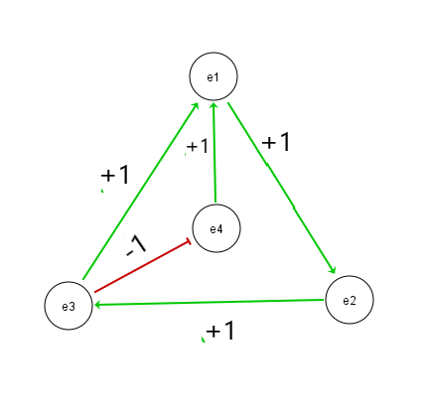

Slide 18
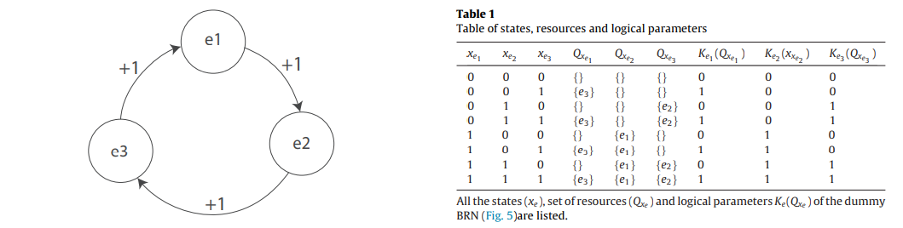

Slide 19
Snoopy

Slide 20
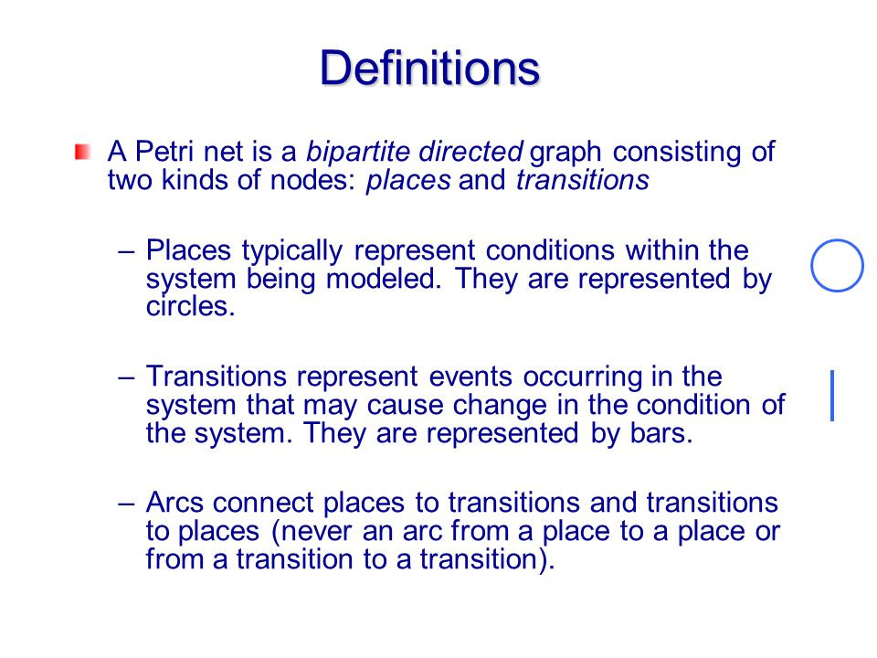

Slide 21
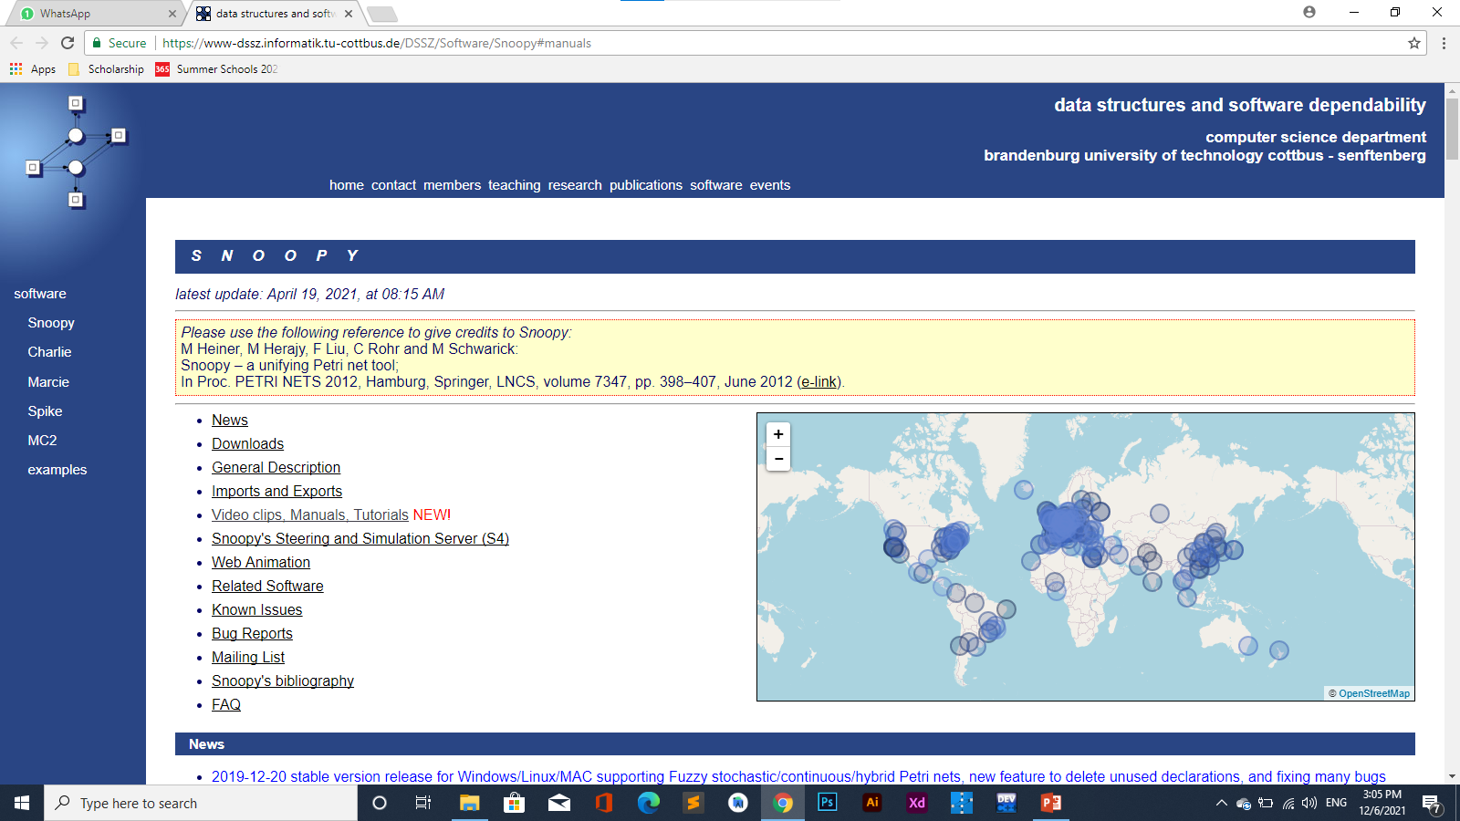
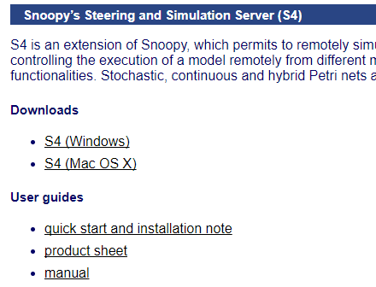
Instillation
Click for this link!
https://www-dssz.informatik.tu-cottbus.de/DSSZ/Software/Snoopy#manuals

Slide 22
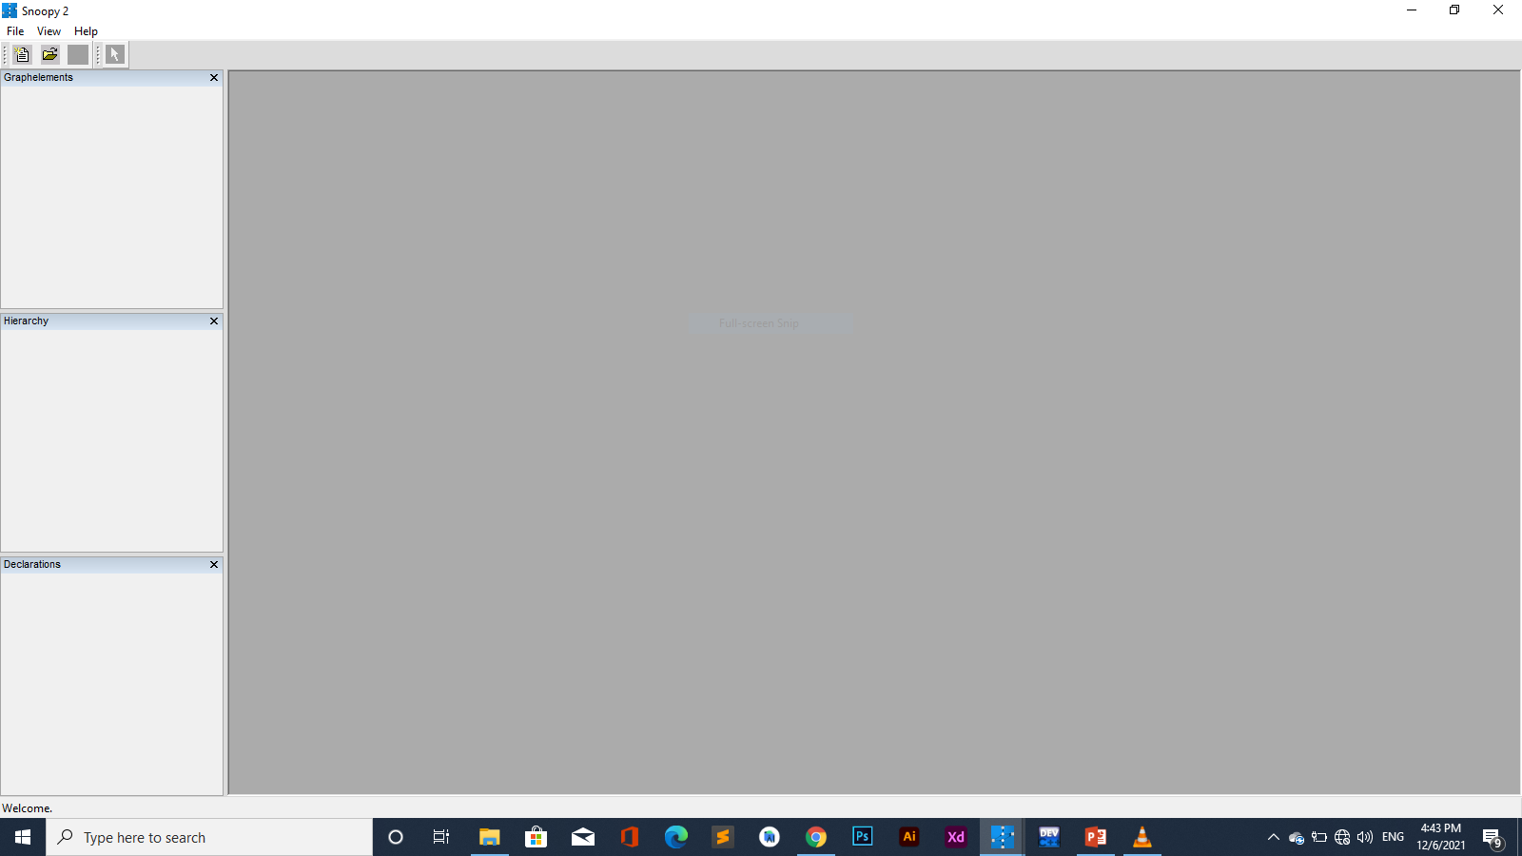
Snoopy Tools Structure

Slide 23
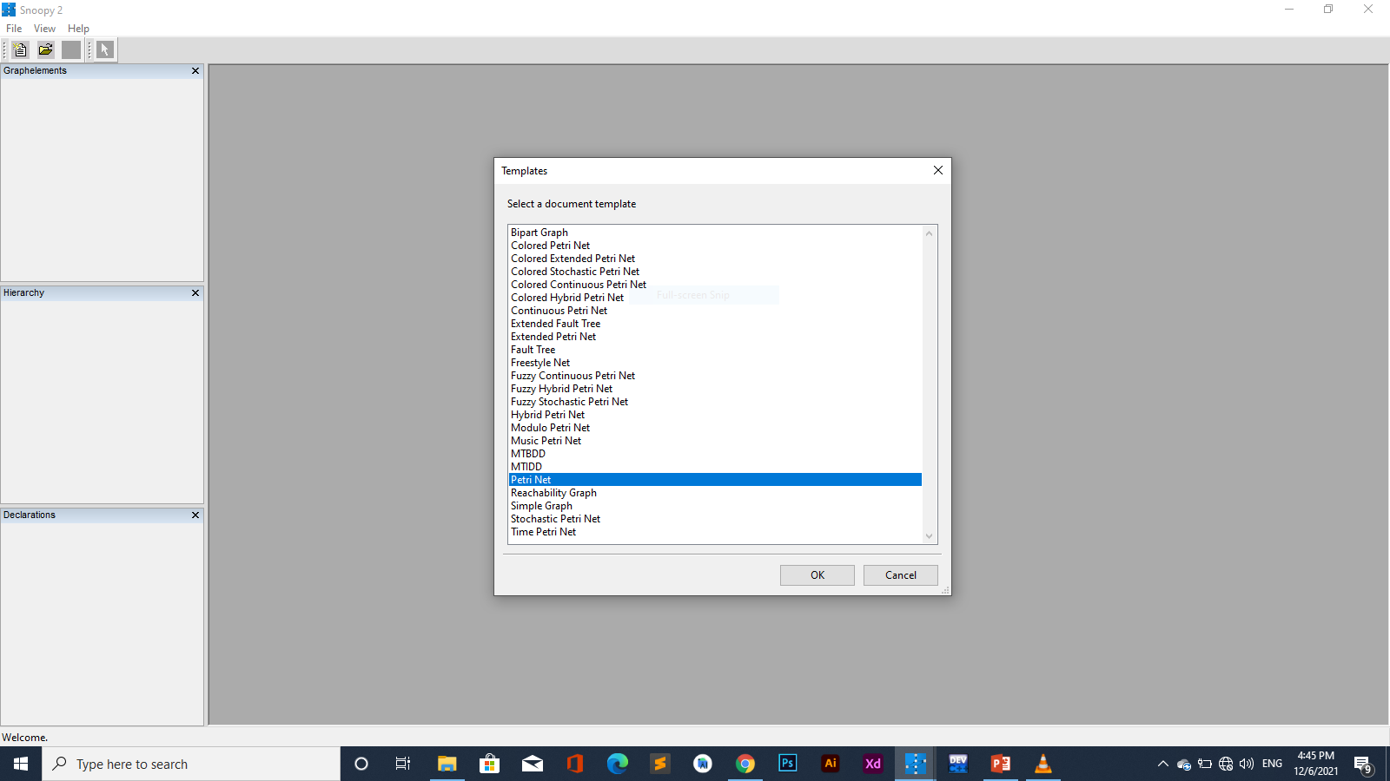
Create New File

Slide 24
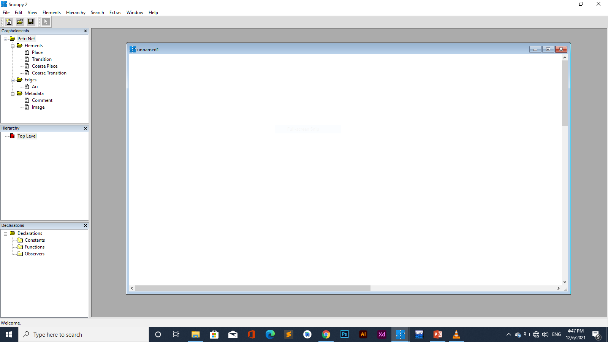
Petri Net Panel

Slide 25
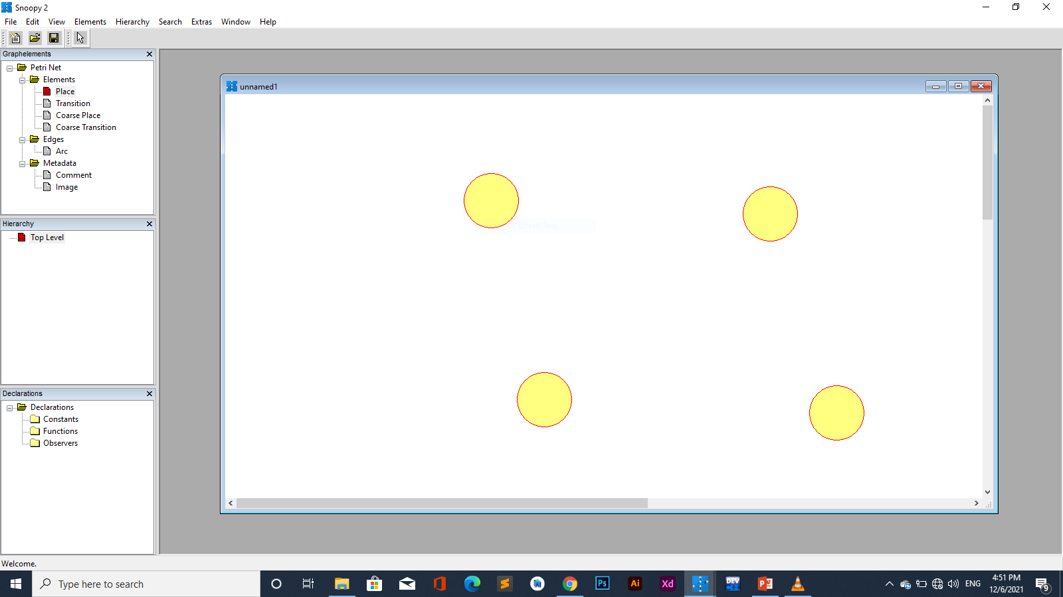
Create Places

Slide 26
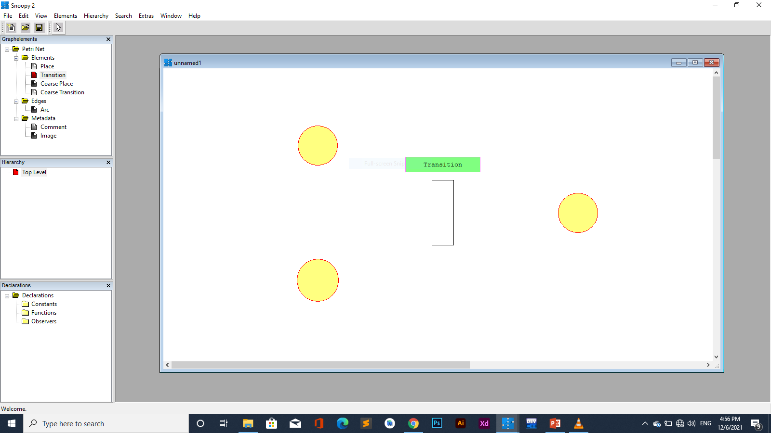
Create Transition

Slide 27
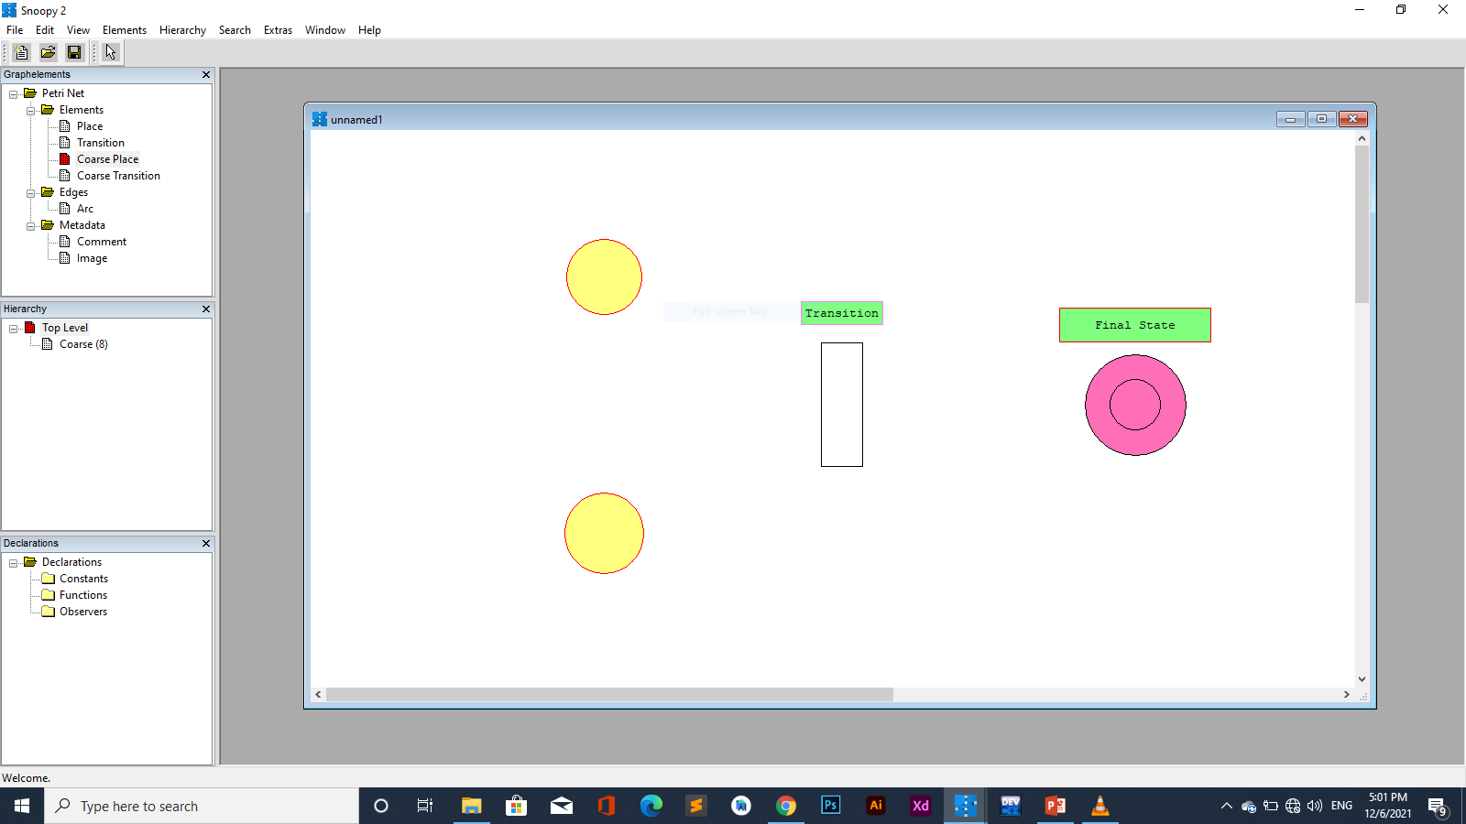
Create Coarse Place

Slide 28
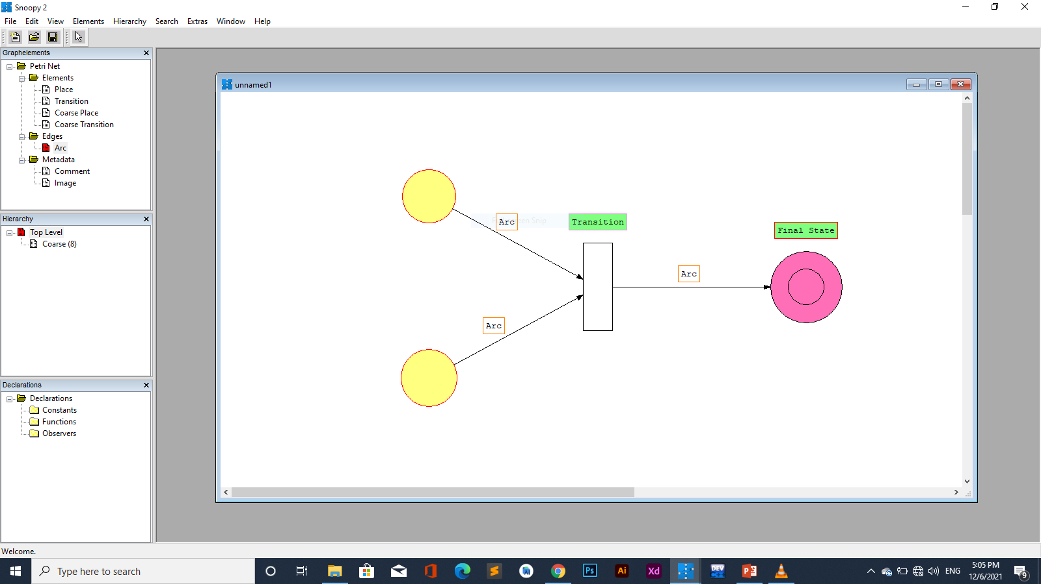
Create Arc

Slide 29
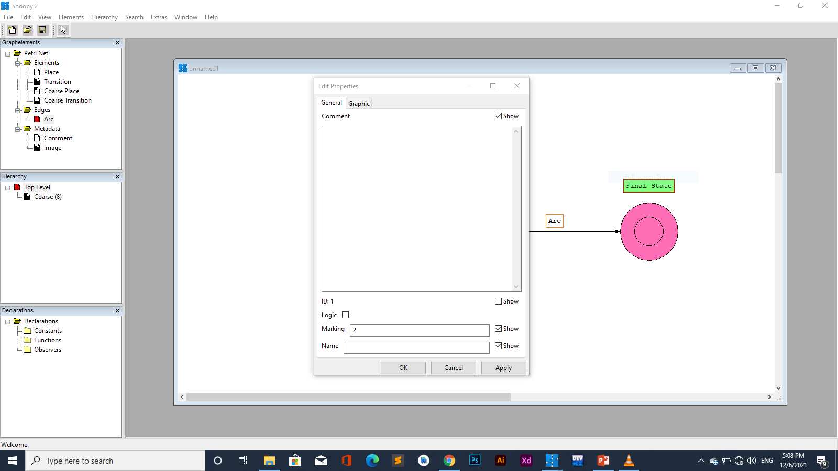
Create Token

Slide 30

Create Token

Slide 31
How To Create A Conceptual Model With Snoopy

Slide 32
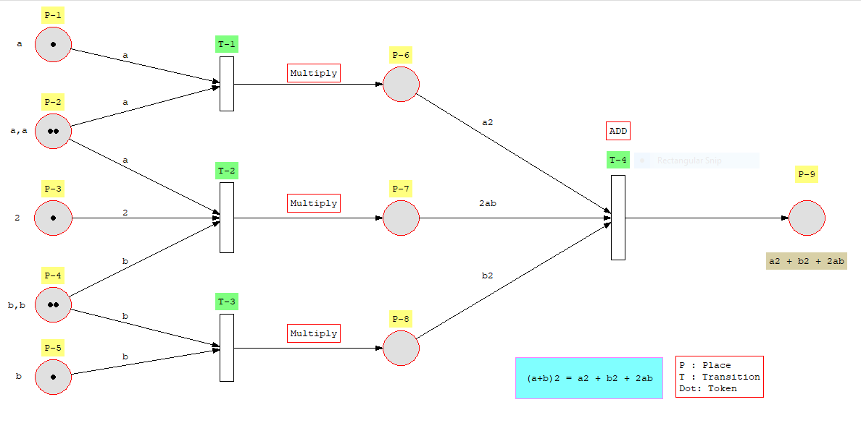

Slide 33
See You Next For
Pint Tool Presentation

Slide 34


